Slide 1
Canadian Bioinformatics Workshops
www.bioinformatics.ca
bioinformaticsdotca.github.io

Slide 2
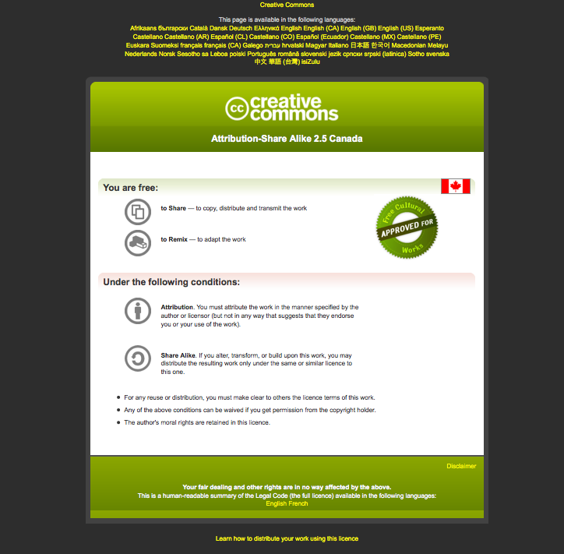

Slide 3



Know Your Data: Exploratory Data Analysis
Shraddha Pai
Analysis Using R
June 13, 2024

Slide 4
Learning Objectives
By the end of this lecture, you will:
Know the basic terminology for terms in a statistical model
Know how to perform systematic exploratory data analysis to to identify sources of biological and technical variation
Appreciate the value of exploring missingness in your data
Have a high level understanding of clustering and be able to cluster your data

Slide 5




Sources of variation in a study
Goal: “Find transcriptomic biomarkers of disease”

Slide 6
Sources of variation in a study
Basic terminology in statistical model building
Response
variable
Explanatory
variable
Residual;
unmodelled
variation
Dependent
variable
Independent
variable

Slide 7
Sources of variation in a study
Basic terminology in statistical model building
coefficients; weights
Intercept

Slide 8
Goal: “Find transcriptomic biomarkers of disease”
Response
variable
Explanatory
variable
Residual;
unmodelled
variation
Dependent
variable
Independent
variable

Slide 9

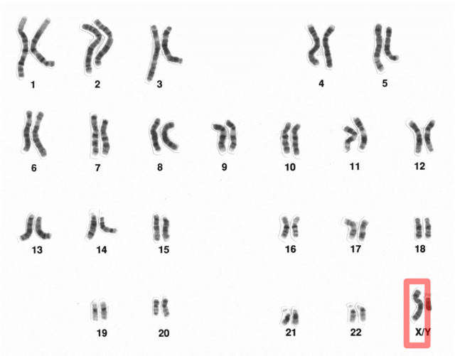
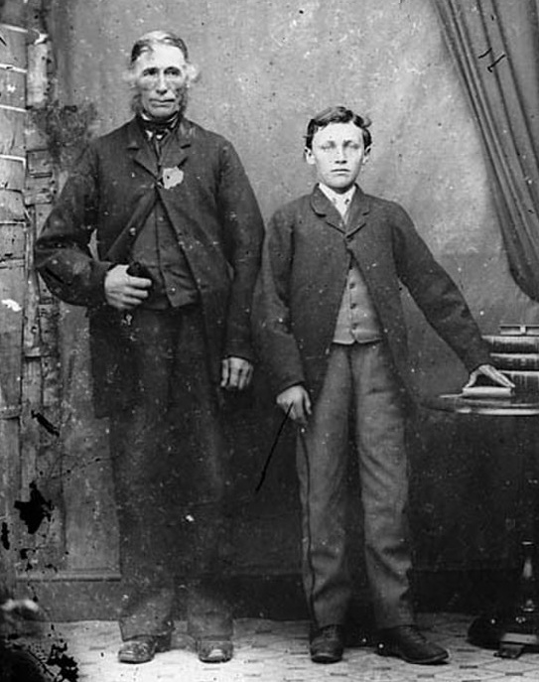

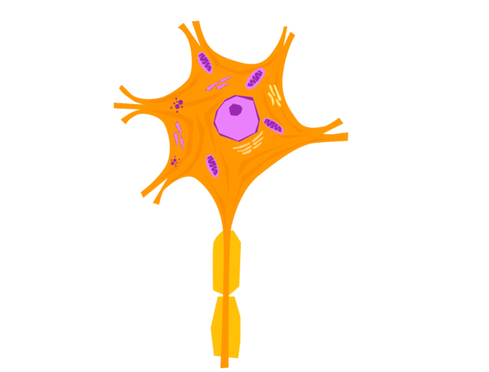
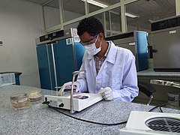
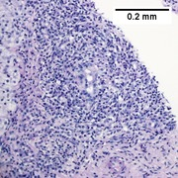
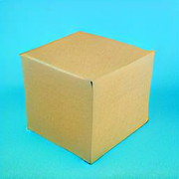
What could be affecting your outcome?
Biological sources of variation
Technical sources of variation
?

Slide 10
“Which of these is affecting my data?”
Visualize & quantify sources of variation:
* clustering * dimensionality reduction (PCA, UMAP, tSNE)
?

Slide 11
Final model
Explanatory variables
Biological variables
Technical
variables
Random
variation*
“Random”: Values sampled from defined statistical distribution (e.g., Normal distribution, Binomial, Poisson etc.,)

Slide 12
Missingness
Missingness happens!
Clinical data may be incomplete (e.g., participant didn’t answer questionnaire)
Multi-’omic data, some participants missing an assay
Some measures didn’t pass QC
Solutions:
Remove rows/cols with “excessive” missingness – use field convention where possible
Use imputation to “guess” at missing values
Ensure your approach is defensible! Careful what you “guess”.
What are trade-offs in each solution?

Slide 13
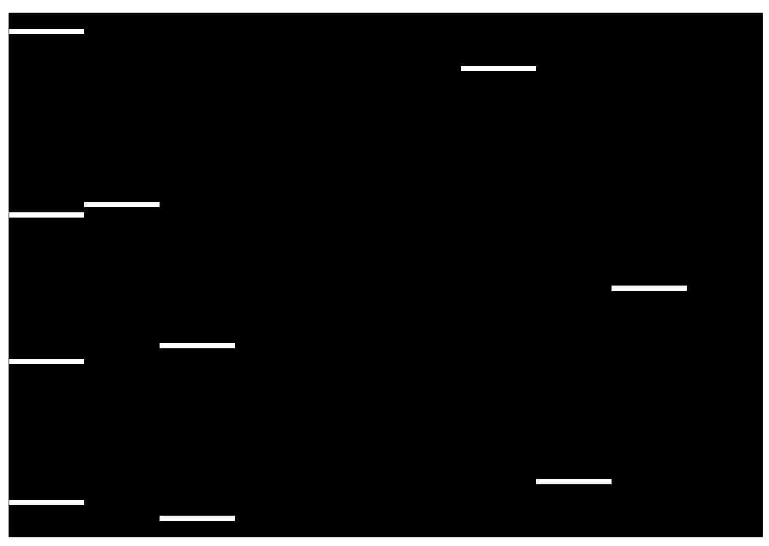
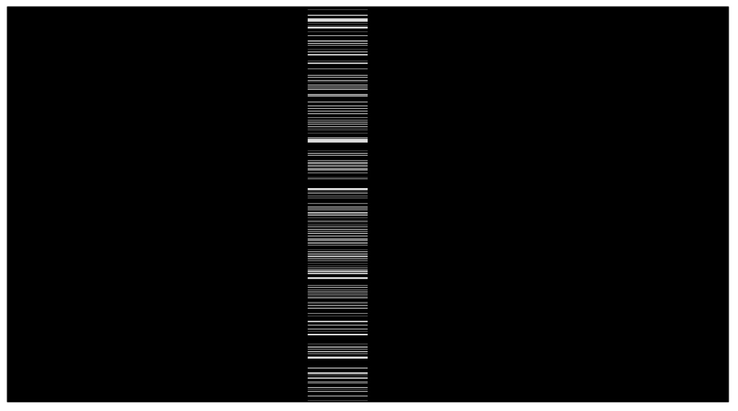

Checkered view of data table. White shows missing (NA).
Unstructured missingness
Structured missingness
Biased, structured missingness
Extreme situation: What if only one group is missing data, and we blindly impute?
Lesson: Where possible, look at your data.

Slide 14
Goals of exploratory data analysis are to:
Identify magnitude of KNOWN biological and technical variation
Identify sources of UNKNOWN variation
Detect OUTLIER samples
Characterize MISSINGNESS

Slide 15

Goals of exploratory data analysis are to:
What you learn
How you learn it
What you do about it
Identify magnitude of KNOWN biological and technical variation
Identify sources of UNKNOWN variation
Detect OUTLIER samples
Characterize MISSINGNESS
PCA*, clustering,
prior knowledge
Add terms to model
PCA*, clustering,
surrogate value analysis
Add terms to model
PCA*, clustering
Exclude samples from analysis
Plot missingness
Exclude measures / samples
Define imputation strategy
* Or other dimensionality reduction technique

Slide 16
Exploratory data analysis: Best practices checklist
Initial exploration
✅ How many measures in metadata?
✅ How many measures in data?
✅ What are the distribution of the measures?
Input: 2 tables: DATA and METADATA
✅ Is there missingness?
Decide solution
measures
(e.g., gene-level expression,
base-level DNA methylation,
voxels)
sample information
(“metadata”)
✅ Examine data correlation structure
* Does the data have natural groupings?
✅ How many major sources of variation are there?
✅ Do they map to biological or technical variables?
Expand model
✅ Are there batch effects?
Attempt removal
✅ Are there unmodelled sources of variation?
Attempt removal
Generate final model
for inferential testing

Slide 17
dim( )
head( )
summary( )
str( ), plots
Initial exploration
✅ How many measures in metadata?
✅ How many measures in data?
✅ What are the distribution of the measures?
sample information
(“metadata”)
count NA
visualize
✅ Is there missingness?
Exclude samples
(caution!!)
Imputation*
Decide solution
measures
✅ Examine data correlation structure
* Does the data have natural groupings?
clustering
✅ How many major sources of variation are there?
✅ Do they map to biological or technical variables?
dimensionality
reduction
Expand model
clustering, dimensionality reduction
✅ Are there batch effects?
Attempt removal
ComBAT
RUVseq*
surrogate variable analysis*
✅ Are there unmodelled sources of variation?
Attempt removal
Generate final model
for inferential testing
linear models,
GLM, edgeR, etc.,
* Not covered in this workshop

Slide 18
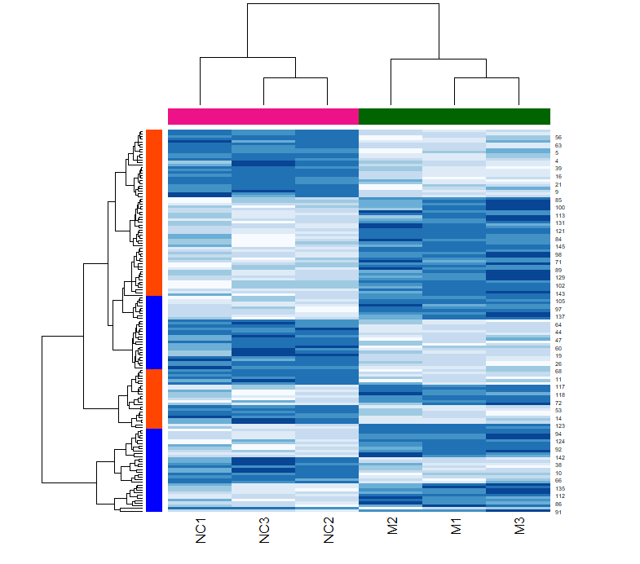
Clustering
High-level purpose: find groups in your data
Your particular purpose (may be):
Identify batches in your data
Identify patient subtypes
Identify groups of coexpressed genes

Slide 19
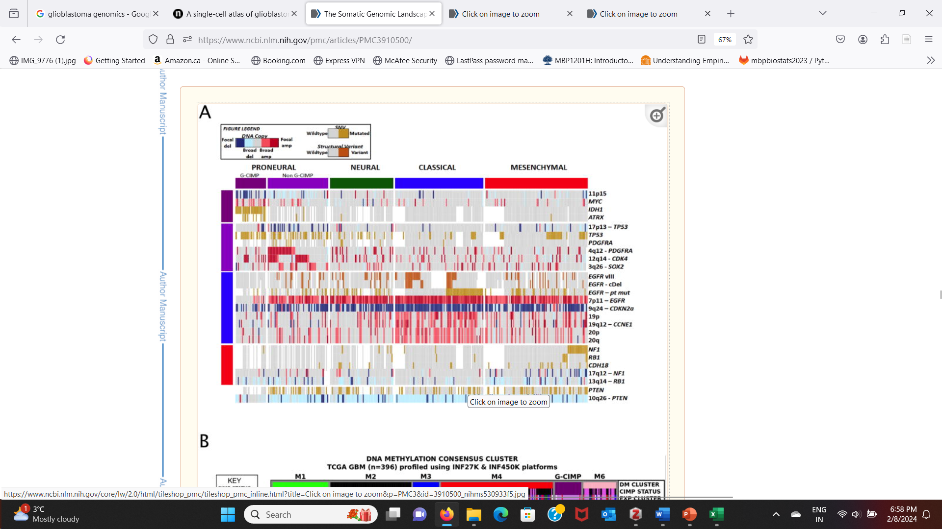
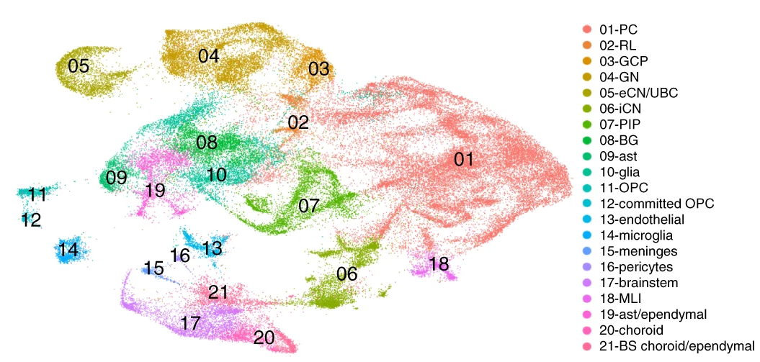
Applications of clustering
Molecular subgroups of glioblastoma
Cell clusters in single-cell genomics
Brennan et al (2013). Cell.
Aldinger et al. (2021). Nat Neurosci.

Slide 20
The heart of clustering: Defining distance between samples
When clustering, you need to find a way to quantify how similar/dissimilar observations are from one another.
This quantity is your “distance metric”
Different data types require different distance metrics
Some data types have many distance metrics, all which come with their own properties.

Slide 21
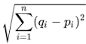
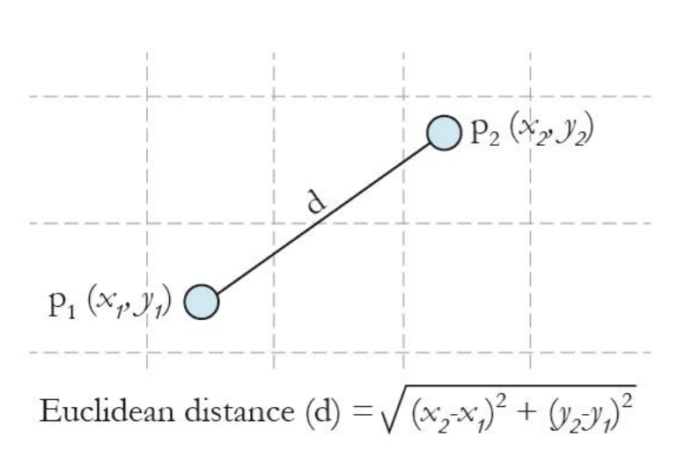
Distance metrics
Continuous variables:
Euclidean distance: Root squared error

Slide 22
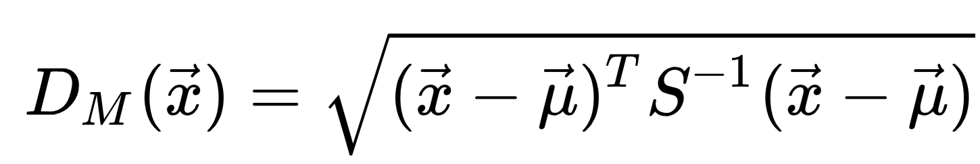
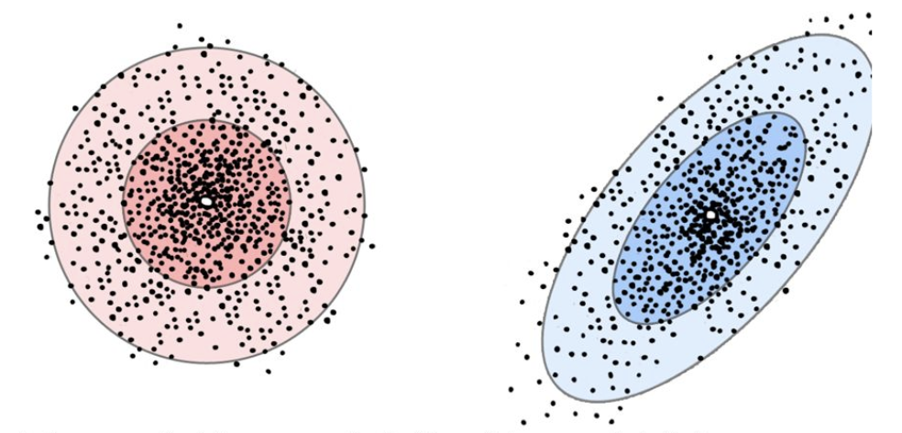
Distance metrics
Euclidean Distance
Ignores correlation between the variables; best if you know data are uncorrelated
(i.e., knowing x does not tell us anything about y).
Mahalanobis Distance
Metric takes into account correlation between variables. Best used if you suspect variables are correlated.
Related term: “similarity”

Slide 23
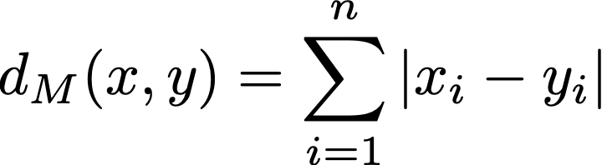
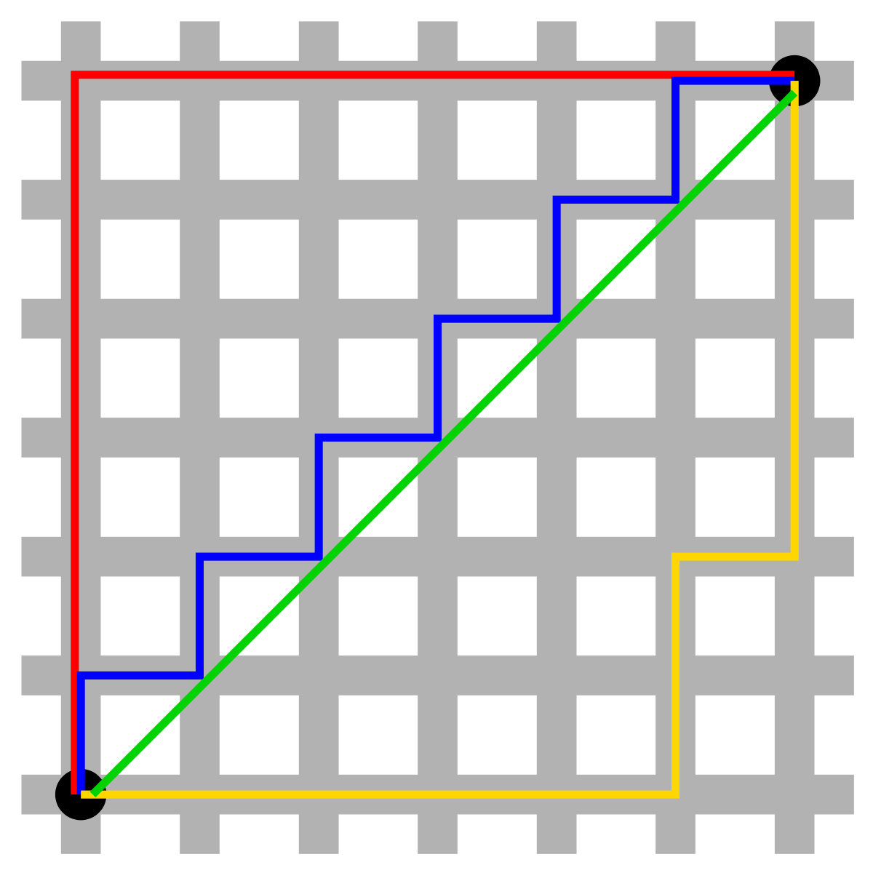
Distance metrics
Continuous variables:
Euclidean distance
Mahalanobis distance
Manhattan or “block” distance:

Slide 24
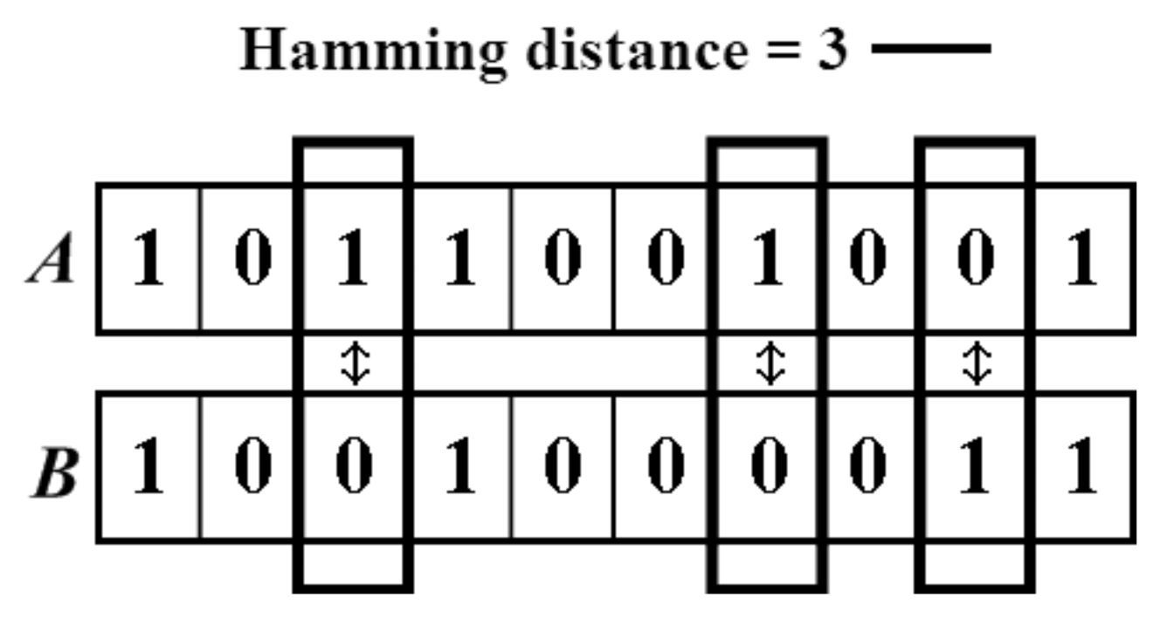
Distance metrics
Continuous variables:
Euclidean distance: Root squared error
Mahalanobis distance (Normalized Euclidean Distance)
Manhattan distance
Categorical variable:
Hamming distance (number of mismatches)

Slide 25
Common clustering approaches
Hierarchical
K-means
Many more…
e.g., Spectral clustering for networks

Slide 26
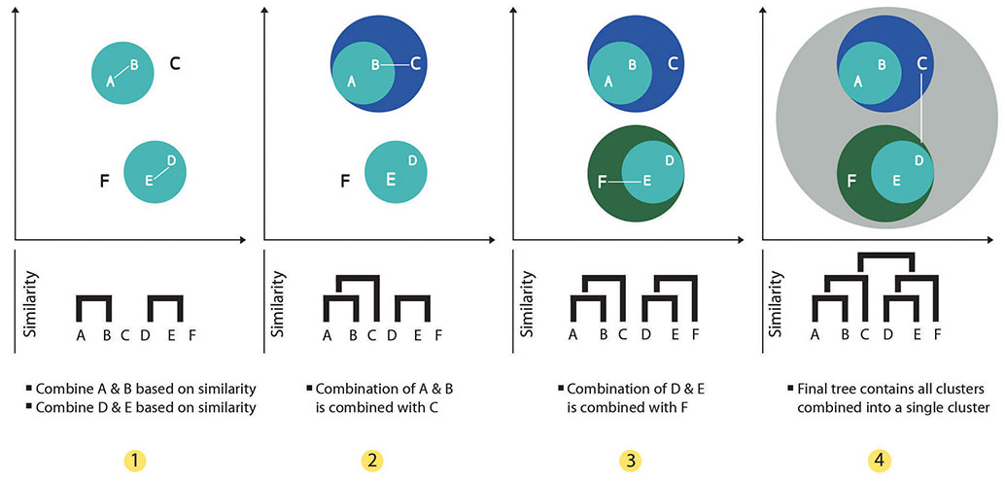
Hierarchical Clustering
Steps:
Build dendrogram
Choose cut point (based on dendrogram or K)

Slide 27
Hierarchical Clustering
Steps:
Build dendrogram
Choose cut point (based on dendrogram or K)

Slide 28

K-Means Clustering
How it works:
Choose number of clusters: k
Set random cluster centers (“centroid”)
For each point:
find closest centroid
assign it to that cluster
Recompute the new centroid for each cluster
Repeat until centroids stop moving (convergence)

Slide 29
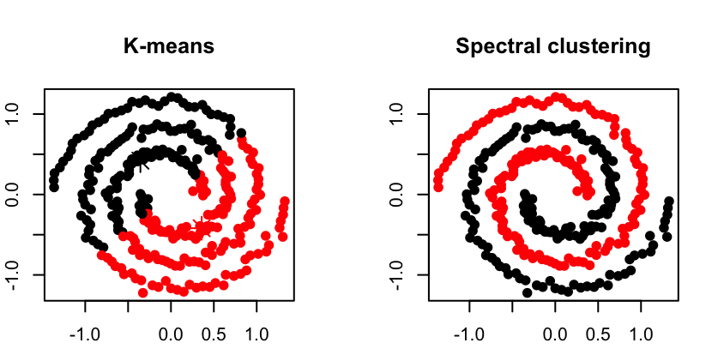
Spectral Clustering
Commonly used for networks/graphs
Operates on pairwise sample similarity (“adjacency”)

Slide 30
Deciding on the number of clusters
We will do this with hclust( ) in the lab
Arbitrarily cutting the dendrogram (by eye)
Silhouette statistic
Dunn Index
Connectivity
And others…
Measured in the clValid package

Slide 31
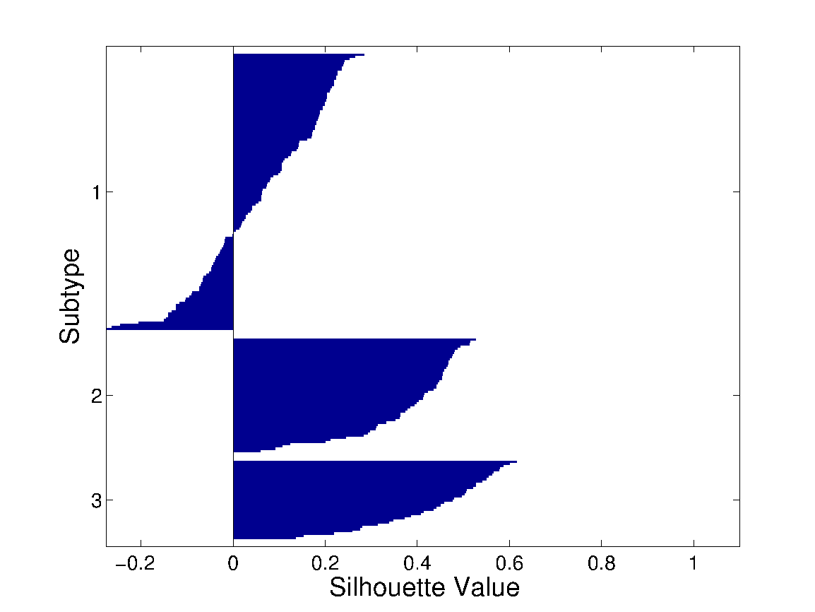
Silhouette width
On average, how similar is a sample to its assigned cluster, compared to other clusters.
Requires identified clusters.
Sample-level
silhouette statistic
average distance to samples in nearest neighbouring cluster
average distance to within-cluster samples
Worst cluster separation
Best cluster separation
-1
0
+1

Slide 32
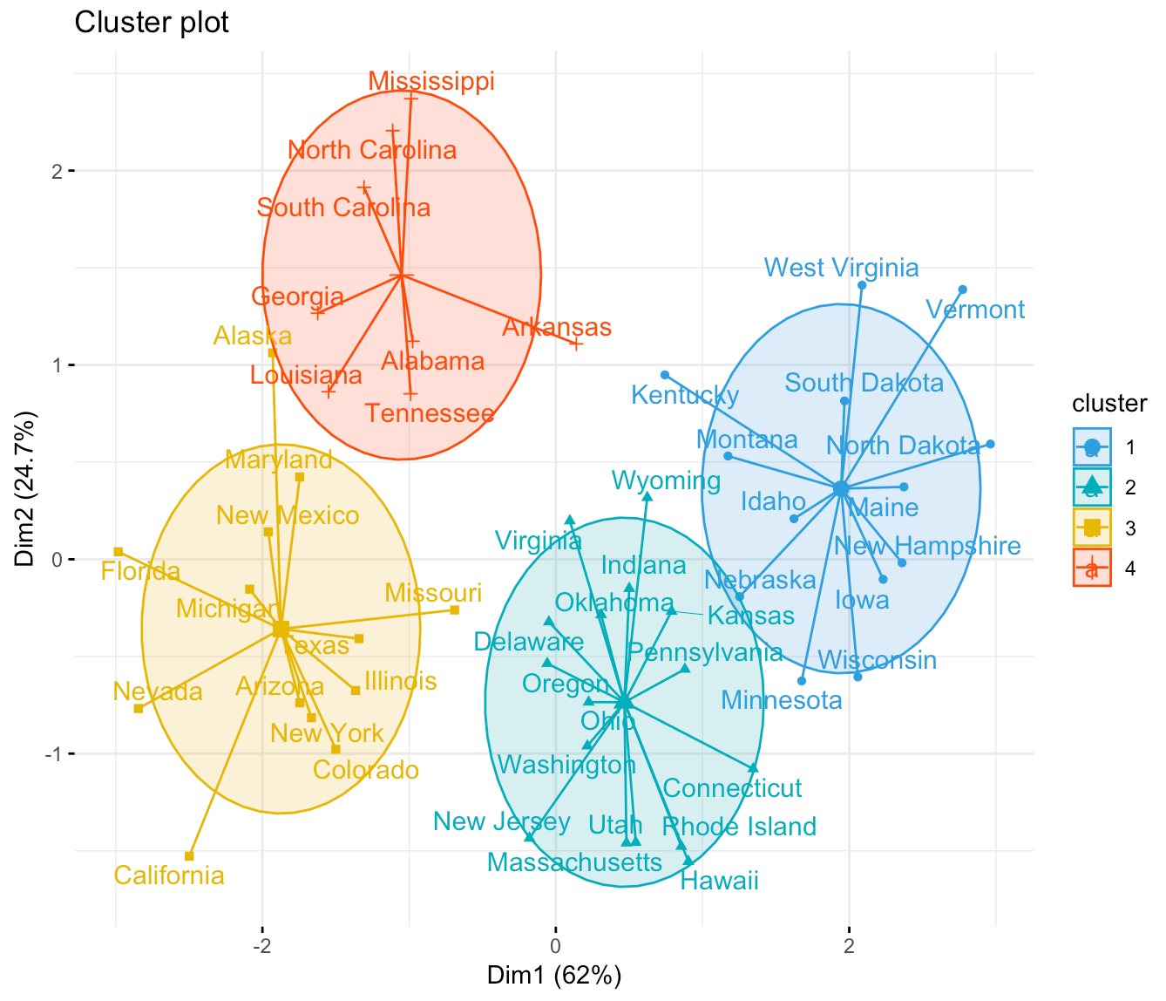
Image source: https://www.datanovia.com/en/lessons/k-means-clustering-in-r-algorith-and-practical-examples/

Slide 33
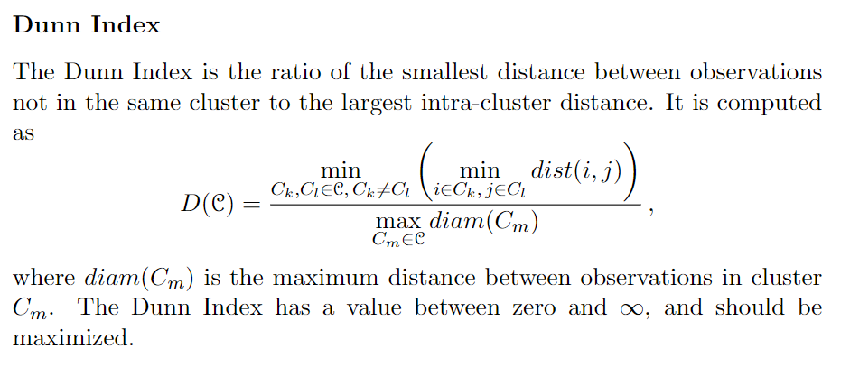
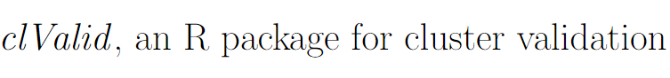
Dunn Index
* Similar to silhouette width. Want to maximize

Slide 34
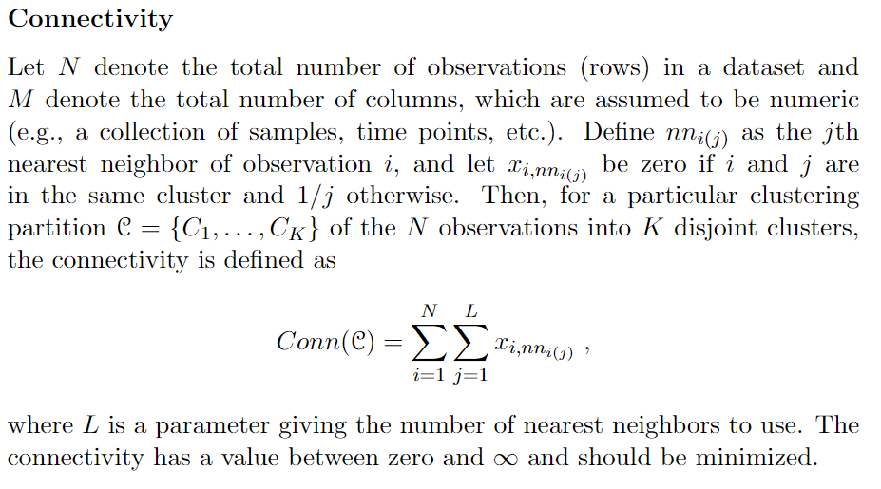
Connectivity
* Counts what fraction of nearest neighbours are not in the same cluster. Note: Should be minimized.

Slide 35
Clustering
Find groups in your data
Requires a distance
Multiple clustering methods exist, pick one appropriate to your application.
Measure goodness of clustering with silhouette, Dunn score or connectivity

Slide 36
Let’s recap!

Slide 37
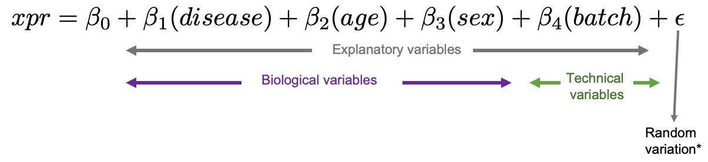
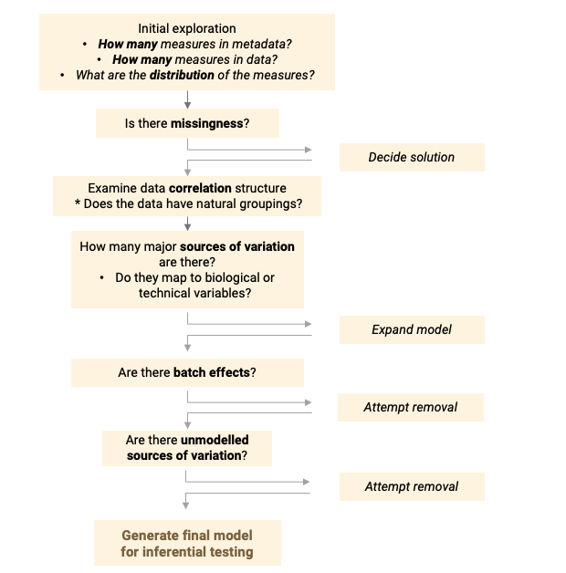
Main points:
The goals of exploratory data analysis are to identify major sources of variation and co-variation,
and identify outliers / missing data
Perform exploratory data analysis in a systematic way using an approach like the one on the left.
Clustering can be used to find natural groupings in data. It requires a distance metric. Clustering can be validated with metrics.

Slide 38
Let’s look at how to achieve EDA and clustering using R.

Slide 39




We are on a Coffee Break & Networking Session
Workshop Sponsors:

